Slide 1
Dance Dance Revolution by Dhea Mariesta Start

Slide 2
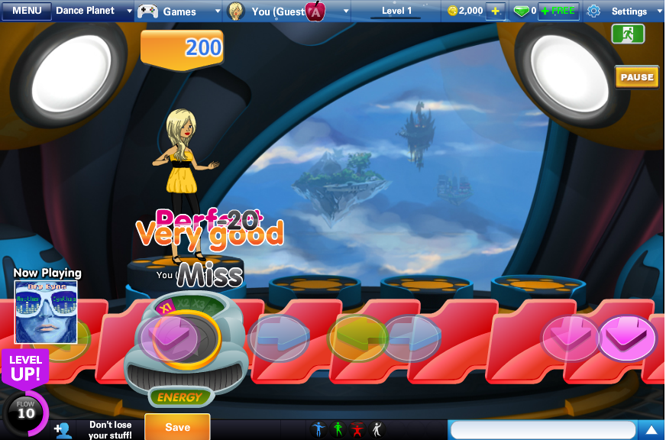
Remember this?

Slide 3
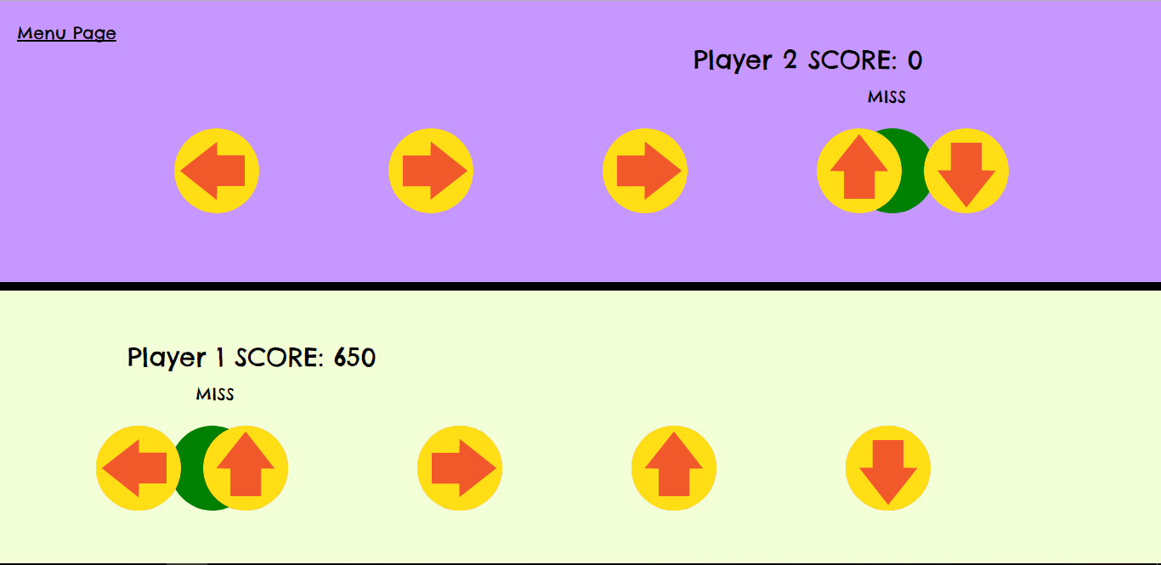
The result

Slide 4
Process
The basic functionalities
Juice
Some other features

Slide 5

Basic functionalities
game
Create the necessary objects
Game, ball, target
Collision detection
Game over when song ended
Scoring system
ball
target

Slide 6



Juice
Sound effect
Collision detection
Mouse hover and mouse click
Ding!
click
Start
Start

Slide 7
Juice
Comments
Excellent, good, bad
Different score based on performance
excellent
good
bad
none

